Slide 1
QR code generator USING PYTHON

Slide 2
CONTENT
Problem Definition
Objective
QR Code
Use of QR Code
Prerequisites
Tools and Technology
Features of Python
Modules used in Project
Screenshots of Code
Screenshots of Output

Slide 3
PROBLEM DEFINITION
Nowadays with the advancement of technology people are spending more time on phones and do everything on the phone. Such as shopping, money transfer, business, marketing etc. Due to which every day some new research, technology keeps coming which makes our work easier. But at the same time, security is declining and people do their work where there is more security and consumes less time and gives more information.

Slide 4
OBJECTIVE
This is a Python project which will create a QR Code of any text or any URL. This will provide Smartphone users with Information, quickly and simply with proper security. QR codes are used wherever data must be understood quickly. They are found on tickets, vending machines, stamps, flyers, posters, and in many other places. In this project QR codes are designed to keep information legible even if they are partially destroyed or obscured. This is achieved by error correction. At the highest security level, the codes can be read even if up to a third of the code has become illegible.

Slide 5
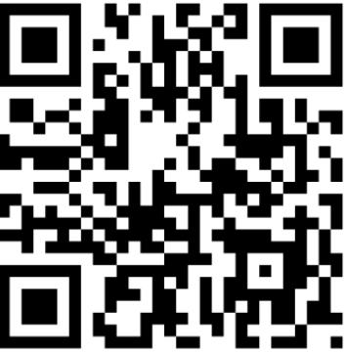
QR CODE
A QR code is a type of barcode that can be read easily by a digital device and which stores information as a series of pixels in a square-shaped grid. QR codes are frequently used to track information about products in a supply chain.
QR code is a type of matrix bar code or two-dimensional code that can store data information and designed to be read by smartphones. QR stands for “Quick Response” indicating that the code contents should be decoded very quickly at high speed. The code consists of black modules arranged in a squCode pattern on a white background. The information encoded may be text, a URL or other data. The QR code was designed to allow its contents to be decoded at high speed. The popularity of QR codes is growing rapidly all around the world. Nowadays, mobile phones with built-in camera are widely used to recognize the QR Code.

Slide 6
USE OF QR CODE
As we are all adjusting to different places and regions requiring contact tracing, QR codes are the easiest way to register your information online and attach it to the QR code in your phone.
Sharing contact details has never been easier than with QR codes.
Addresses – personal home address, business address Phone numbers – personal telephone number, your company’s phone number E-mail addresses – personal or business accounts URLs – addresses of websites or specific web pages Links to apps – found in app stores such as Google Play or Apple’s App Store Payments – QR codes can store information about your bank account or credit card Online accounts authentication – websites can display a QR code which a registered user can scan with his or her smartphone and automatically log in

Slide 7
PREREQUISITES
Hardware Requirements:
Laptop with basic hardware
Software Requirements:

Slide 8
Tools and Technology
Python:
Python is a widely used general-purpose, high level programming language. It was created by Guido van Rossum in 1991 and further developed by the Python Software Foundation. It was designed with an emphasis on code readability, and its syntax allows programmers to express their concepts in fewer lines of code.
Python is a widely used general-purpose, high level programming language. It was created by guido van rossum in 1991 and further developed by the python software foundation. It was designed with an emphasis on code readability, and its syntax allows programmers to express their concepts in fewer lines of code.
Python is a programming language that lets you work quickly and integrate systems more efficiently.
It is used for: Web development (server-side), Software development, Mathematics, System scripting.
Python has syntax that allows developers to write programs with fewer lines than some other programming languages. Python runs on an interpreter system, meaning that code can be executed as soon as it is written. This means that prototyping can be very quick.

Slide 9
Features of Python
Python is easy to learn as compared to other programming languages. Its syntax is straightforward and much the same as the English language.
Python can perform complex tasks using a few lines of code.
Python is an interpreted language; it means the Python program is executed one line at a time. The advantage of being interpreted language, it makes debugging easy and portable.
Python can run equally on different platforms such as Windows, Linux, UNIX, and Macintosh, etc. So, we can say that Python is a portable language.
Python supports object-oriented language and concepts of classes and objects come into existence. It supports inheritance, polymorphism, and encapsulation, etc. The object-oriented procedure helps to programmer to write reusable code and develop applications in less code.
It implies that other languages such as C/C++ can be used to compile the code and thus it can be used further in our Python code. It converts the program into byte code, and any platform can use that byte cthar.
In Python, we don’t need to specify the data-type of the variable. When we assign some value to the variable, it automatically allocates the memory to the variable at run time.

Slide 10
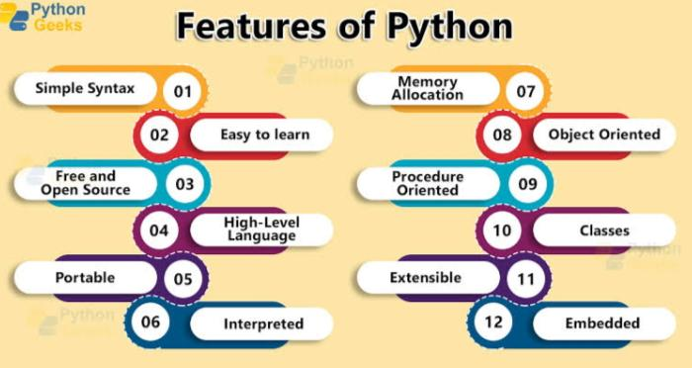

Slide 11

MODULES USED IN THE PROJECT
It has the cerate function which will be used to generate the qrcode. It doesn’t come pre-installed with python and hence we have to install it manually. We can install this by simply running pip install pyqrcode command from the terminal.

Slide 12
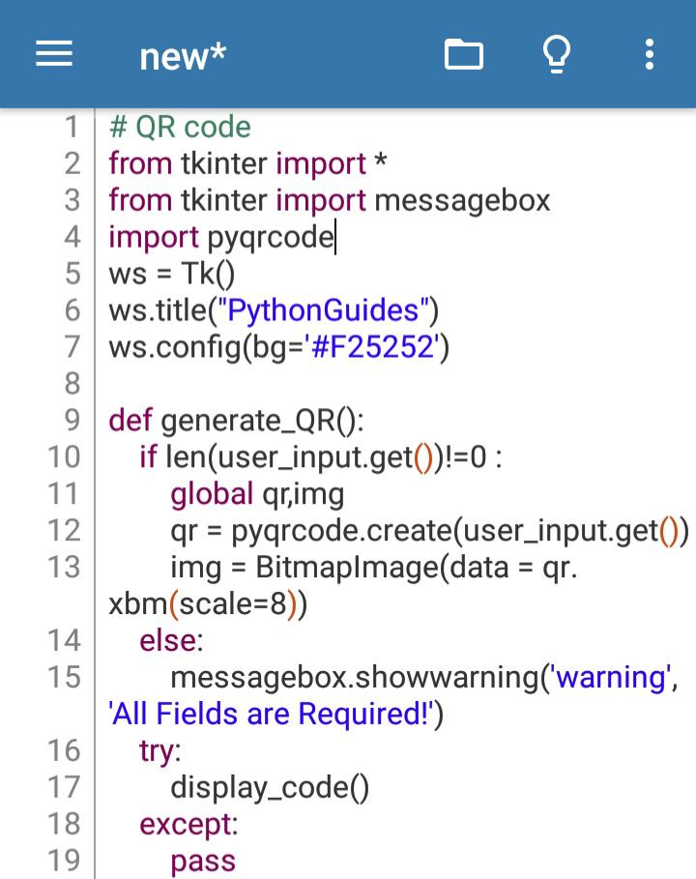
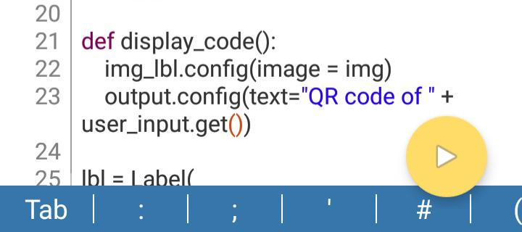
SCREENSHOTS OF CODE

Slide 13
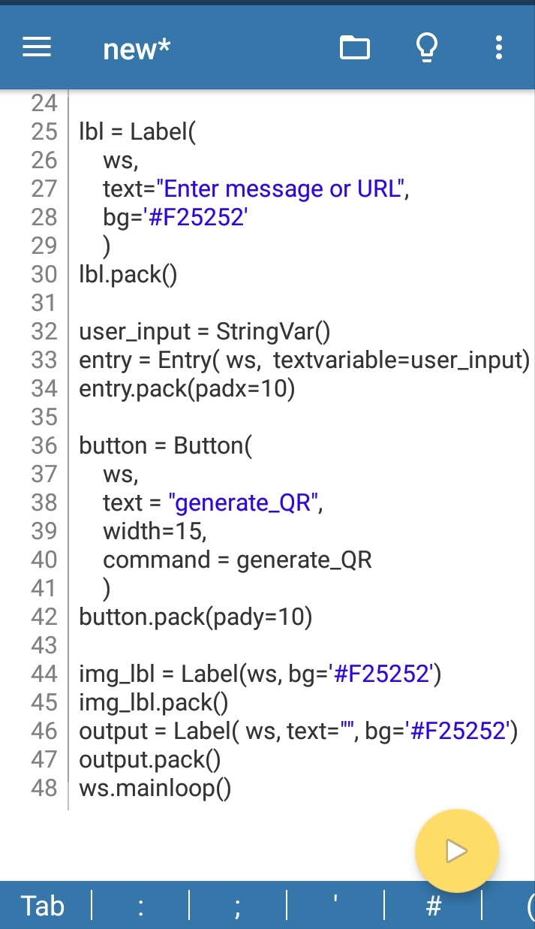

Slide 14
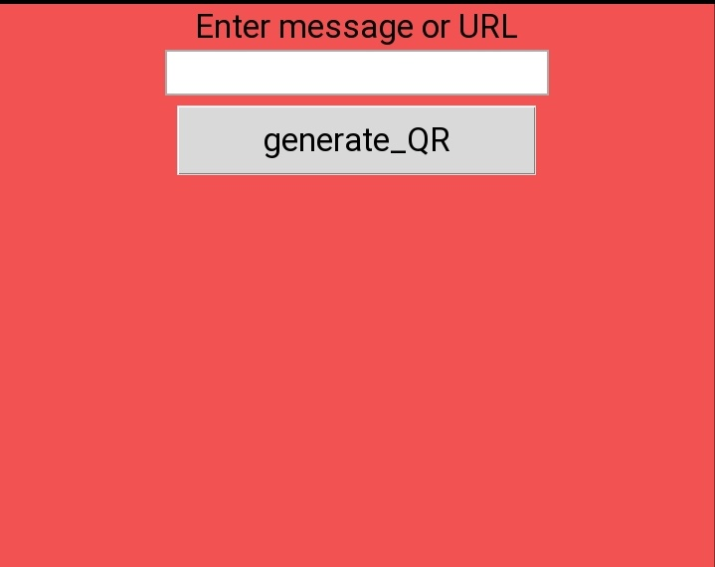
SCREENSHOTS OF OUTPUT

Slide 15
